Slide 1

Generalized Sorting with Predictions by Lu P., Ren X., Sun E. and Zhang Y. Discussion by A. Petkovic and G. Delande
INFOH400 - Algorithms for big data, Professor John Iacono

Slide 2
Introduction
The paper was presented during the 2021 Symposium on Simplicity in Algorithms (SIAM SOSA21).
Motivating example, inspired by Huang et al (2011)
An academic department hiring a new tenure.
Several candidates:
Assume there is a ‘real’ ranking.
Possible to compare candidates by pairs, but...
You need to send a (favour) letter, and…
Only some candidates are comparable.
Furthermore, assume there are predictions of the ranking (e.g. reading or interview). (new)
Key = limiting comparisons

Slide 3
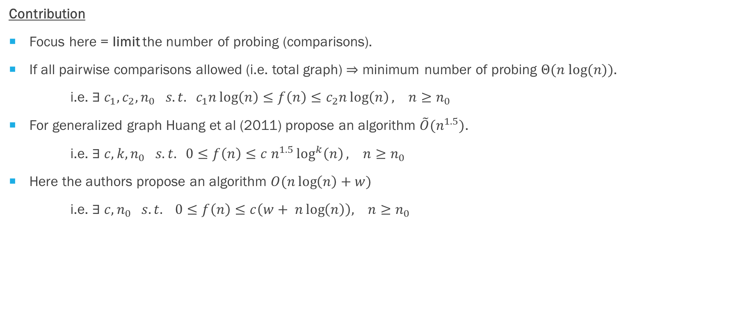
Introduction
Contribution
Focus here = limit the number of probing (comparisons).
If all pairwise comparisons allowed (i.e. total graph) $⇒$ minimum number of probing $Θ(n log⁡(n))$.
i.e. $∃{ c}_{1},c_{2},n_{0} s.t. { c}_{1}n\log\left(n\right)≤f\left(n\right)≤c_{2}n\log\left(n\right), n≥n_{0}$
For generalized graph Huang et al (2011) propose an algorithm $\tilde{O}(n^{1.5})$.
i.e. $∃ c, k,n_{0} s.t. 0≤f\left(n\right)≤c{ n}^{1.5}\log^{k}\left(n\right), n≥n_{0}$
Here the authors propose an algorithm $O(n\log\left(n\right)+w)$
i.e. $∃ c, n_{0} s.t. 0≤f\left(n\right)≤c\left(w+ n\log\left(n\right)\right), n≥n_{0}$
(Add prediction)

Slide 4
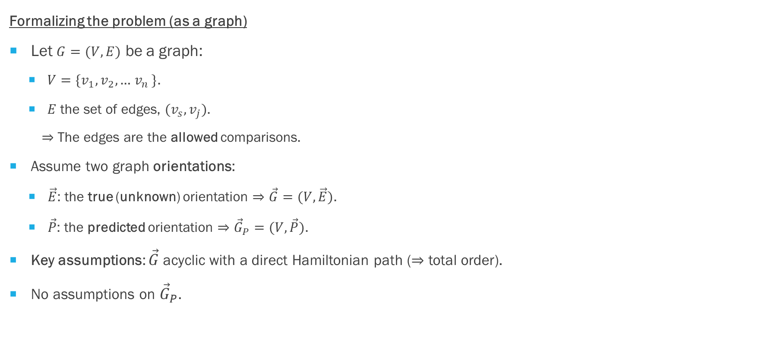
Formalizing the problem
Formalizing the problem (as a graph)
Let $G=(V,E)$ be a graph:
$V=\{v_{1},v_{2},\text{…} v_{n }\}$.
$E$ the set of edges, $(v_{s},v_{j})$.
$⇒$ The edges are the allowed comparisons.
Assume two graph orientations:
$\vec{E}$: the true (unknown) orientation $⇒\vec{G}=(V,\vec{E})$.
$\vec{P}$: the predicted orientation $⇒{\vec{G}}_{P}=(V,\vec{P})$.
Key assumptions: $\vec{G}$ acyclic with a direct Hamiltonian path ($⇒$ total order).
No assumptions on ${\vec{G}}_{P}$.

Slide 5
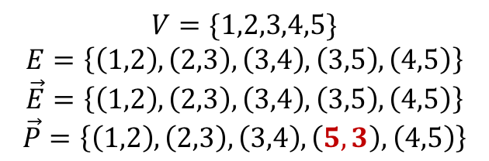
Formalizing the problem - illustration
Illustration
1
2
3
4
$$V=\{1,2,3,4,5\}$$
$$E=\left\{\left(1,2\right), \left(2,3\right), \left(3,4\right),\left(3,5\right), \left(4,5\right)\right\}$$
$$\vec{E}=\left\{\left(1,2\right), \left(2,3\right), \left(3,4\right),\left(3,5\right), \left(4,5\right)\right\}$$
$$\vec{P}=\left\{\left(1,2\right), \left(2,3\right),\left(3,4\right),\left(5,3\right), \left(4,5\right)\right\}$$
5
Incorrect prediction

Slide 6


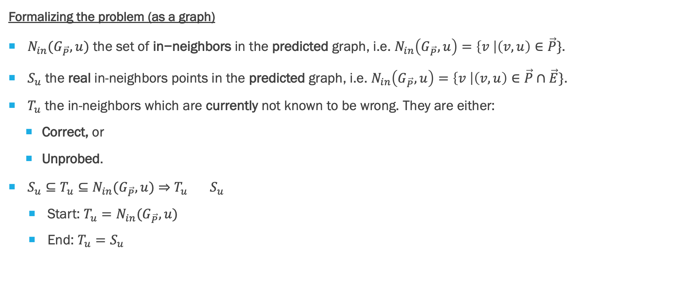
Formalizing the problem
Formalizing the problem (as a graph)
$N_{in}(G_{\vec{P}},u) \text{the} \text{set} \text{of} \text{in}\text{−}\text{neighbors} \text{in} \text{the} \text{predicted} \text{graph}\text{, }\text{i}\text{.}\text{e}\text{. }N_{in}\left(G_{\vec{P}},u\right)=\left\{v \right|\left(v,u\right)∈\vec{P}\}\text{. }$
$S_{u}$ the real in-neighbors points in the predicted graph, i.e. $N_{in}\left(G_{\vec{P}},u\right)=\left\{v \right|\left(v,u\right)∈\vec{P}∩\vec{E}\}$.
$T_{u}$ the in-neighbors which are currently not known to be wrong. They are either:
Correct, or
Unprobed.
$S_{u}⊆T_{u}⊆N_{in}(G_{\vec{P}},u)$ $⇒$ $T_{u} { S}_{u}$
Start: $T_{u}=N_{in}(G_{\vec{P}},u)$
End: $T_{u}{=S}_{u}$
$$S_{u}$$
$$N_{in}(G_{\vec{P}},u)$$

Slide 7
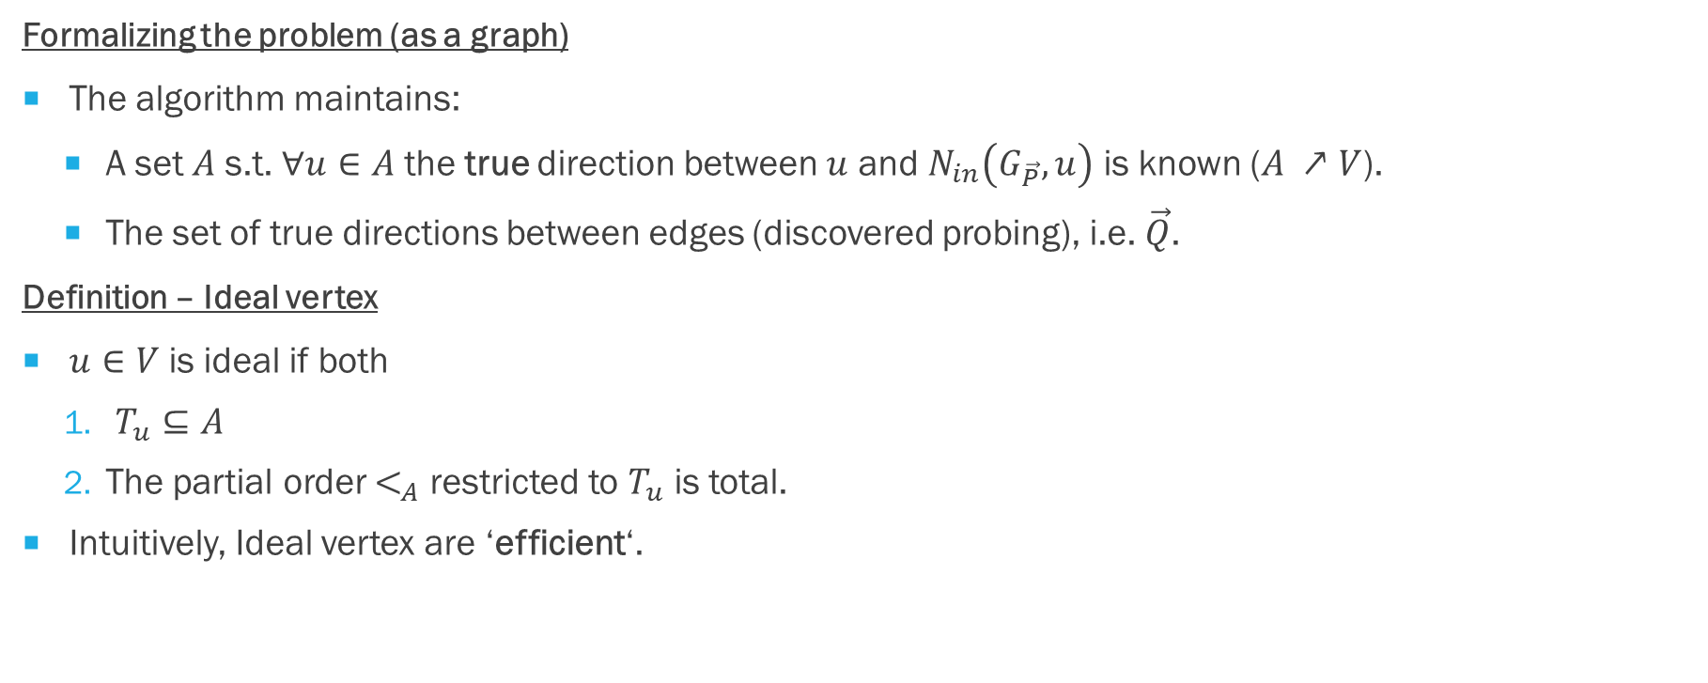
Formalizing the problem
Formalizing the problem (as a graph)
The algorithm maintains:
A set $A$ s.t. $∀u∈A$ the true direction between $u$ and $N_{in}\left(G_{\vec{P}},u\right)$ is known ($A ↗V$).
The set of true directions between edges (discovered probing), i.e. $\vec{Q}$.
Definition – Ideal vertex
$u∈V$ is ideal if both
$T_{u}⊆A$
The partial order $<_{A}$ restricted to $T_{u}$ is total.
Intuitively, Ideal vertex are ‘efficient‘.

Slide 8
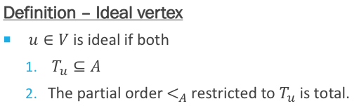
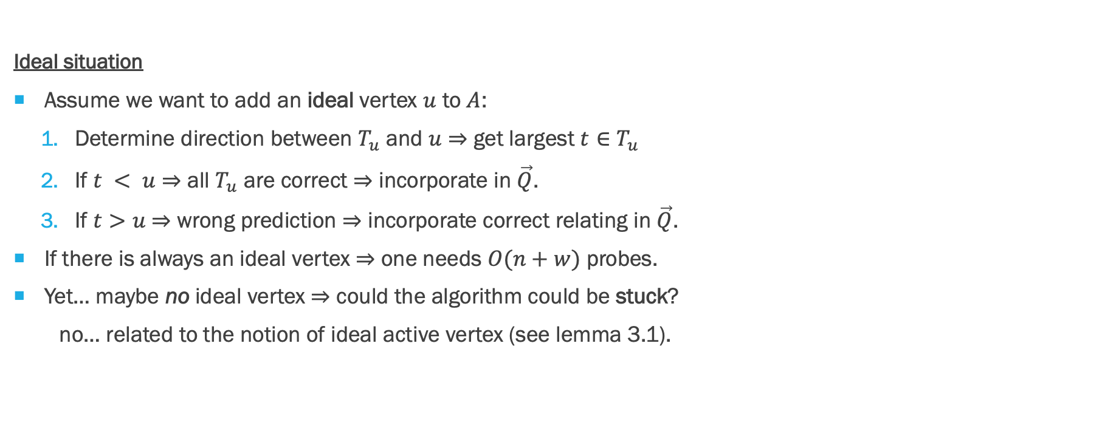
Ideal and active vertices
Ideal situation
Assume we want to add an ideal vertex $u$ to $A$:
Determine direction between $T_{u}$ and $u$ $⇒$ get largest $t∈T_{u}$
If $t < u$ $⇒$ all $T_{u}$ are correct $⇒$ incorporate in $\vec{Q}$.
If $t>u$ $⇒$ wrong prediction $⇒$ incorporate correct relating in $\vec{Q}$.
If there is always an ideal vertex $⇒$ one needs $O(n+w)$ probes.
Yet… maybe no ideal vertex $⇒$ could the algorithm could be stuck?
no… related to the notion of ideal active vertex (see lemma 3.1).

Slide 9
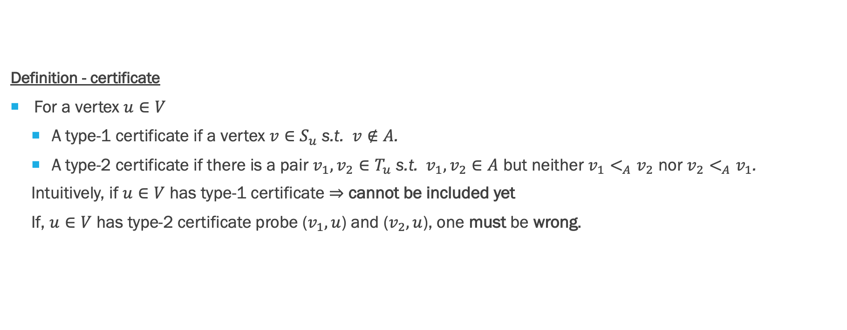
certificates
Definition - certificate
For a vertex $u∈V$
A type-1 certificate if a vertex $v∈S_{u}$ s.t. $v∉A$.
A type-2 certificate if there is a pair $v_{1}, v_{2}∈T_{u}$ s.t.${ v}_{1}, v_{2}∈A$ but neither $v_{1}<_{A}v_{2}$ nor $v_{2}<_{A}v_{1}$.
Intuitively, if $u∈V$ has type-1 certificate $⇒$ cannot be included yet
If, $u∈V$ has type-2 certificate probe ($v_{1},u$) and ($v_{2},u$), one must be wrong.

Slide 10
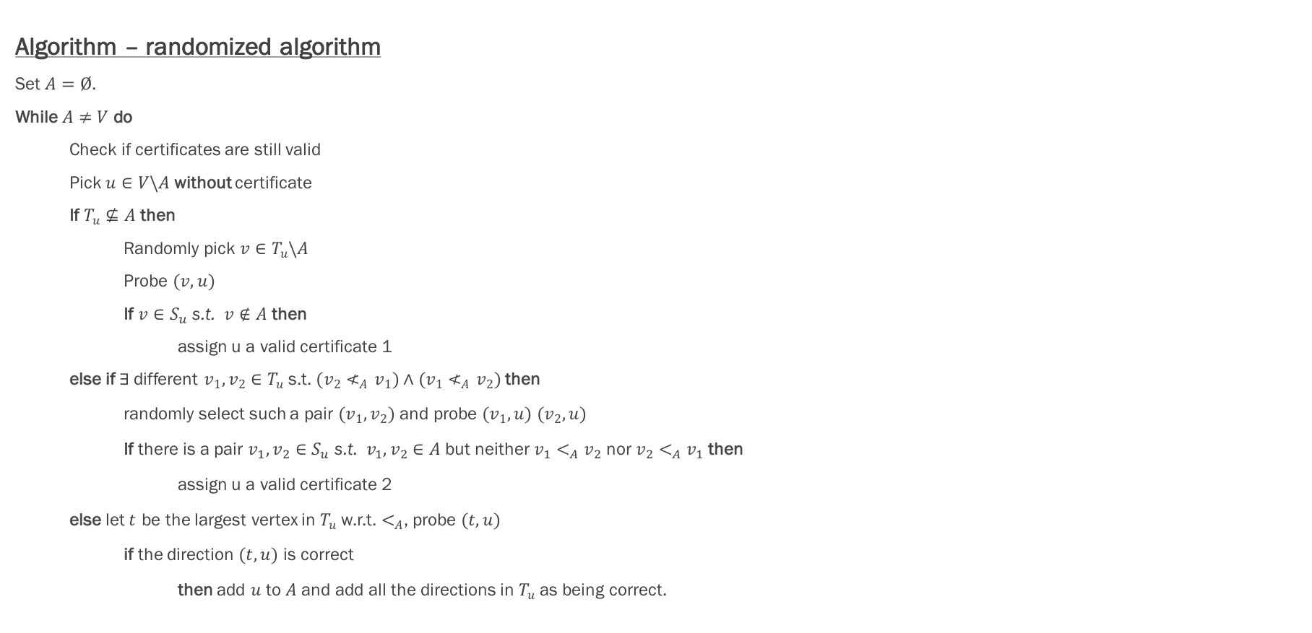
Appendix The algorithm - illustration
Example 1 - No ideal vertex – certificate 1 (illustration)
1
2
3
4
Illustration – iterating on ideal
Step 1: Add 1, $A=\{1\}$
Step 2: Add 2, $A=\{1,2\}$
Step 3:
$T_{3}=\{1,2,5\}⊈A$
$T_{4}=\{3\}⊈A$
$T_{5}=\{4\}⊈A$
$⇒$ No ideal vertex.
5

Slide 11

The algorithm - illustration
Example 1 - No ideal vertex – certificate 2 (illustration)
1
2
3
4
5
The algorithm is random. Assume the following sequence.
Step 1: 1, $T_{1}=empty$ => $A=\{1\}$
Step 2: 5, $T_{5}=empty$ => $A=\{1,5\}$
Step 3: 2, $T_{2}=\{1\}$ => $A=\left\{1,2,5\right\}$
Step 4: 4, $T_{4}=\{2,5\}$ but there is no order between these => one of (2,4) or (5,4) is incorrect.

Slide 12
The algorithm
Algorithm – randomized algorithm
Set $A=Ø$.
While $A≠V$ do
Check if certificates are still valid
Pick $u∈V\backslash A$ without certificate
If $T_{u}⊈A$ then
Randomly pick $v∈T_{u}\backslash A$
Probe $(v,u)$
If $v∈S_{u}$ s.t. $v∉A$ then
assign u a valid certificate 1
else if $∃$different $v_{1},v_{2}∈T_{u}$ s.t. $(v_{2}≮_{A}v_{1})∧(v_{1}≮_{A}v_{2})$ then
randomly select such a pair $(v_{1},v_{2})$ and probe $(v_{1},u)$ $(v_{2},u)$
If there is a pair $v_{1}, v_{2}∈S_{u}$ s.t.${ v}_{1}, v_{2}∈A$ but neither $v_{1}<_{A}v_{2}$ nor $v_{2}<_{A}v_{1}$ then
assign u a valid certificate 2
else let $t$ be the largest vertex in $T_{u}$ w.r.t. $<_{A}$, probe $(t,u)$
if the direction $(t,u)$ is correct
then add $u$ to $A$ and add all the directions in $T_{u}$ as being correct.
One vertex might have become an active vertex
Condition 1 for u being an ideal vertex is NOT satisfied
u is NOT an active vertex neither
Condition 2 for u being an ideal vertex is NOT satisfied
u is NOT an active vertex neither

Slide 13
The algorithm - implementation
General information:
Implementation was done in a Jupyter Notebook, in Python
Notebook accessible through the link
Comments in the notebook: link paper-implementation as clear as possible

Slide 14
The algorithm - implementation
Creating graphs:
generate_graph(n = 5, pc = 0.5): randomly create directed graphs
create_mispredicted_graph(correct_graph = generate_graph(), ppred = 0.7): simulate a non-perfect prediction of the correct graph by creating some mis-predicted edges
convert_tuples_to_dict(list_of_edges): convert the list of tuples into a Python dictionary
Representation of graphs: key-values
Key: [Values]
A specific vertex
List of in-neighbors* associated to the
specific key/vertex
* In-neighbor of a vertex = incoming neighbor of a vertex, i.e. edge is: (in-neighbor, vertex)

Slide 15
The algorithm - implementation
Recording and checking for partial order with a matrix:
Purpose: check the partial order of a set, in order to know if two different vertices share a common path
Our Method:
Use a matrix to store the known relations/edges between the vertices of a set (e.g. set of probed edges or set A).
Use a function to « screen » and update the matrix
Pros and cons:
PROS: simplicity, less computationally intensive for smaller graphs
CONS: requires vertices to be aligned with rows and columns of the matrix (extra assumptions), not optimal for dealing with very high amount of vertices

Slide 16
The algorithm - implementation
Recording and checking for partial order with a matrix:
In practice:
Start with an empty matrix indicating that there are no known relations
Matrix of size (n,n), where n is the number of nodes in the graph
Edges are probed before being added to a set → only use upper right half of the matrix (because in-neighbor < vertex), and edges are always in correct direction
Each time an edge (v,u) is added to a set (e.g. to probed edges, A), add a -1 at the position (v, u) in the matrix → requires vertices to be aligned with rows and columns of the matrix
Automatically compute the paths (Discovery function)
1
2
3
4
Example:
add edge (1, 2) to the set
add edge (3, 4) to the set
add edge (2, 3) to the set
0
0
0
-1
-1
-1
1
0
-1
-1
2
0
0
0
0
0
-1
3
0
0
0
4
0
0
0
0

Slide 17
Wrap uP
Explained the underlying theory of the paper
Provided examples to illustrate some of the main concepts
Provided our own suggestions for the implementation
We implemented the algorithm in Python

Slide 18
references
Huang Z., Kannan S. and Khanna S. (2011): Algorithms for the Generalized Sorting Problem, 2011 Institute of Electrical and Electronics Engineers 52nd Annual Symposium on Foundations of Computer Science
Lu P., Ren X., Sun E. and Zhang Y. (2021): Generalized Sorting with Predictions, Symposium on Simplicity in Algorithms

